Slide 1
Sustainable Dredging through Community Involvement
Presented by Marie Burns
Duval county resident
Principal, EcoLogix group

Slide 2
Lessons learned from port of Baltimore
Maryland changed it’s approach in 2001 – dredged material management act
Previously “met requirements”:
Port generated placement options/ideas
Formal public comment
Now-partnership through the harbor team – “beyond requirements”
Stakeholder participation begins with project selection, options/ideas, community enhancements
Facilitators conduct meetings, Mpa/corps/state agencies provide technical support
Stakeholder involvement continues through option development, construction and operation
Stakeholders trust the process / are invested in the outcome

Slide 3
Harbor team charge “give recommendations on placement of 500,000 cy of dredged material per year for Baltimore harbor”
Members represent local communities, community activists, local jurisdictions, maritime industry, ngo’s, other stakeholders and stakeholder organizations
Empowerment of stakeholders directly into long-term planning process
Innovative and beneficial use of dredged material
final report in 2003 issued after 9 months of meetings held an average of every 3 weeks.

Slide 4
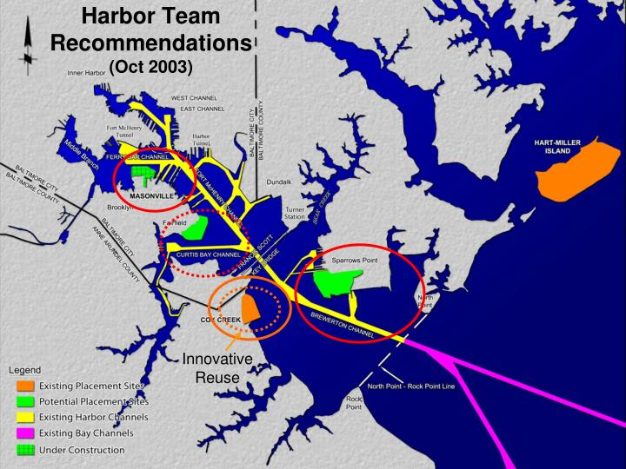

Slide 5
The rest of the story
Previous adversarial relationship transformed into a partnership
Realized they had common goals for economy, environment, and health
Recommendations sent unfiltered to governor
recommendations were adopted by Dmmp executive committee
Harbor team continues to meet with the same charge
Permitting and planning time frames greatly reduced

Slide 6
“harbor team” for jaxport
Creation of a stakeholder team patterned after the Port of Baltimore harbor team with the charge of giving recommendations to decision makers on placement of and beneficial use of dredged material for jaxport.
Members would represent local communities, community activists, local jurisdictions, maritime industry, ngo’s, other stakeholders and stakeholder organizations.
Technical support from Jaxport, Jacksonville district corps of engineers, and state of florida.

Slide 7
The adventure of creating a “Harbor Team”
total commitment from the Port and team members to participate
investment in time and dollars
no committee chair; facilitator role - keeps the process on track, becomes a liaison between stakeholders and the Port, does not represent the Port, writes up final report.
No guarantee recommendations are adopted but they will know why if they are not adopted.
Can feel initially like jumping without a parachute!

Slide 8
Beneficial use of dredged material
Stakeholders would hear presentations by Corps, Port, and other experts on beneficial uses of dredged material - regional sediment management
Stakeholders – what do you want your shoreline to look like?
Environmental enhancements/restoration
Shoreline stabilization

Slide 9
Benefits to jaxport and the community
Enhanced and regular communication on sensitive issues
Allows input early in the planning process
Seek to create win-win for all parties
Early knowledge of port initiatives with opportunity for input
Turning an adversarial situation into a collaborative effort
Savings for Port and Corps in both time and dollars

Slide 10
Thank you!
Additional information:
Mr. Frank Hamons – Former Maryland Port Administration, Deputy director for harbor development (410-682-5595)
Ms. Chris correale – current director of harbor development, former chief of Operations in Corps’ Baltimore District (410-385-4465)
David Flores Baltimore Harbor Waterkeeper – (410-254-1577)
Harry Wujek - North Point Peninsula Council (we can put him in contact with you)
Mark Galloway – W.r. Grace & Co.
Mr. Bob Hoyt – Ecologix group and helped create Harbor Team (301-906-9691)
Masonville Dredged material containment facility example: https://www.youtube.com/watch?v=1nv3_OiEzLM

